Slide 1

SQL DATA ANALYST PROJECT
By
Giridharan Kannan

Slide 2
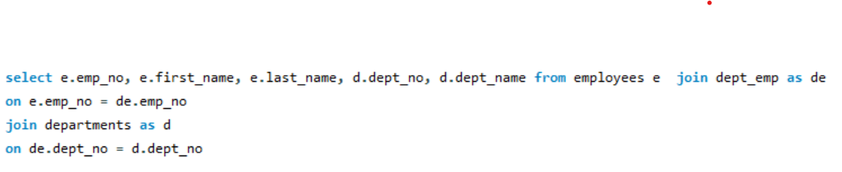
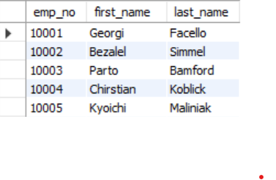
1. List of Employment by Departments
Question: Write a query to list all employees along with their respective department names. Include employee number, first name, last name, department number, and department name.
Query:
Output:

Slide 3
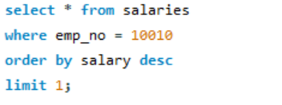
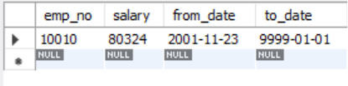
2. Current and Past Salaries of an Employee
Question: Write a query to retrieve all the salary records of a given employee (by employee number).-- Include employee number, salary, from_date and to_date.
Query:
Output:

Slide 4
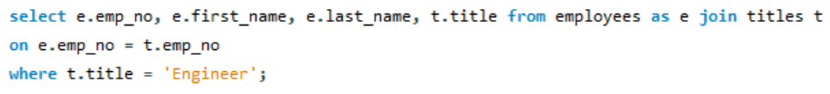
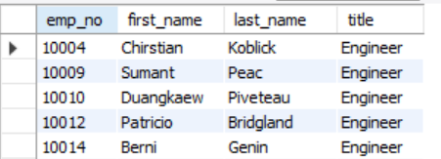
3. Employees with Specific Titles
Question: Write a query to find all employees who have held a specific title (e.g., 'Engineer').Include employee number, first name, last name, and title.
Query:
Output:

Slide 5
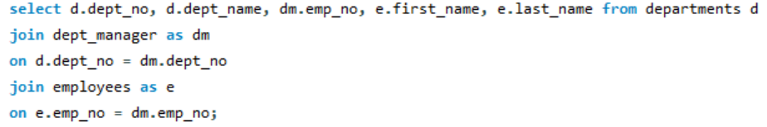
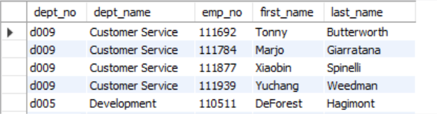
4. Departments with Their Managers
Question: Write a query to list all departments along with their current managers. Include department number, department name, manager's employee number, first name, and last name.
Query:
Output:

Slide 6
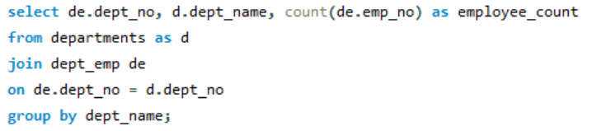
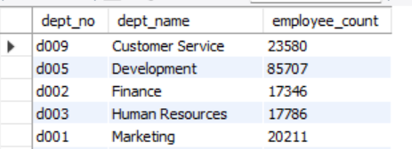
5. Employee Count by Department
write a query to count a number of employees in each department. Include department number, department name and employee count.
Query:
Output:

Slide 7

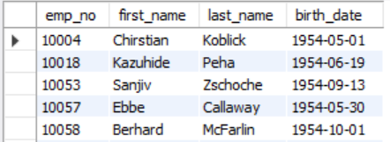
6. Employees Birthdates in a Given Year
Question: Write a query to find all employees born in a specific year (e.g., 1953, 1980, like that).Include employee number, first name, last name, and birth date.
Query:
Output:

Slide 8
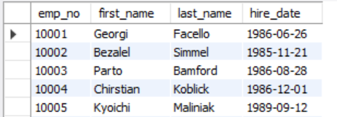
7. Employees Hired in the Last 50 Years
Question: Write a query to find all employees hired in the last 50 years. Include employee number, first name, last name, and hire date.
Query:
Output:

Slide 9
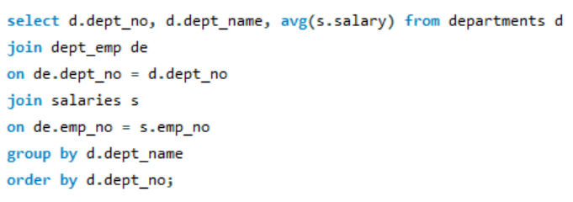
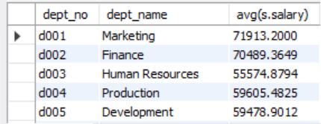
8. Average Salary by Department
Question: Write a query to calculate the average salary for each department. Include department number, department name, and average salary..
Query:
Output:

Slide 10
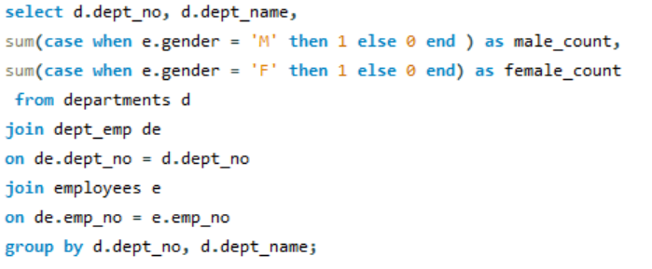
9.Gender Distribution in Each Department
Question: Write a query to find the gender distribution (number of males and females) in each department. -- Include department number, department name, count of males, and count of females.
Query:

Slide 11
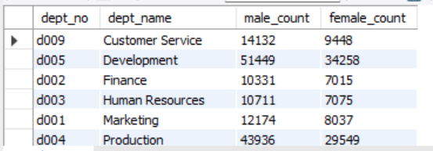
0utput:

Slide 12
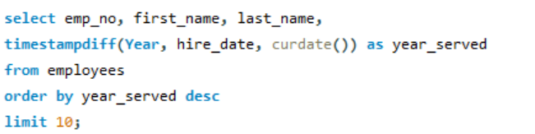
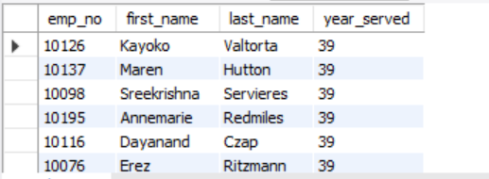
10. Longest Serving Employees
Question: Write a query to find the employees who have served the longest in the company. Include employee number, first name, last name, and number of years served.
Query:
Output:

